Slide 1
Social Media for A Department
Marcia DiStaso, Ph.D. APR
Chair Public Relations Department
@mdistaso

Slide 2
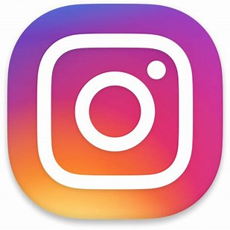
What’s your social appetite?
@mdistaso

Slide 3
Want to know if students will use your social media accounts?
Ask them!
@mdistaso

Slide 4
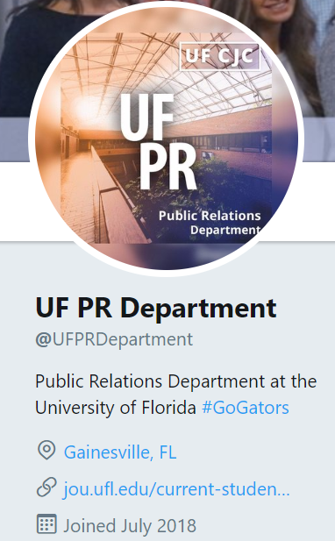
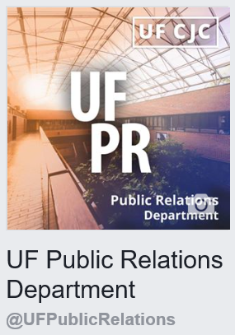
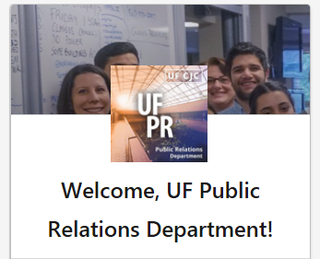
@mdistaso

Slide 5
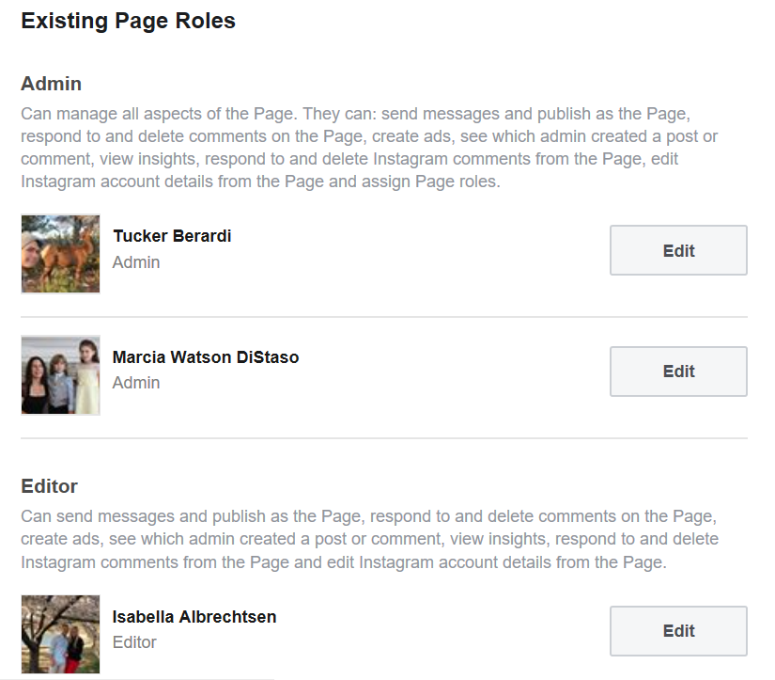
It takes
a team!
@mdistaso

Slide 6
Mistakes
happen!
@mdistaso

Slide 7
All eyes are on how you handle it!
@mdistaso

Slide 8
Main Audience = Students
Secondary = Faculty, Alumni & Professionals
@mdistaso

Slide 9
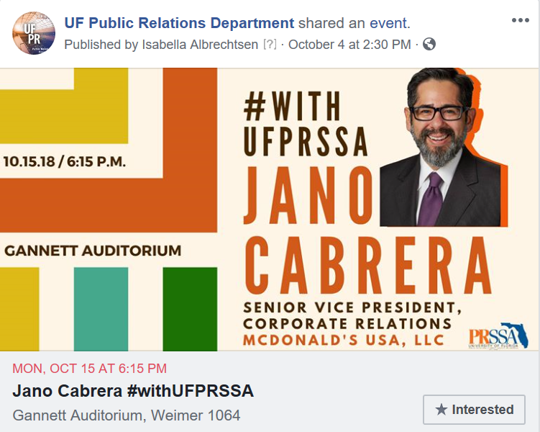
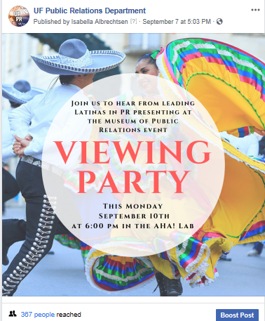
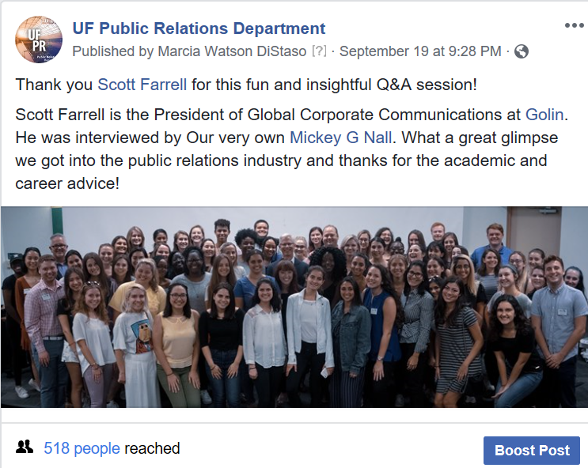
Facebook Goal =
Inform about what we have going on
@mdistaso

Slide 10
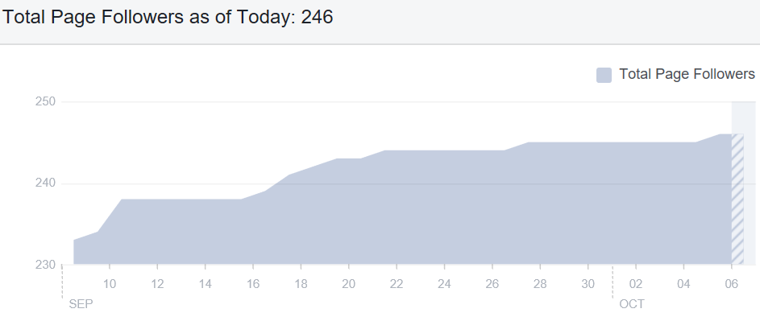
@mdistaso

Slide 11
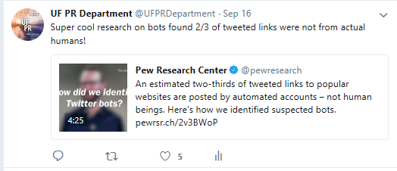
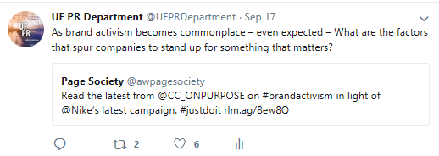
Twitter Goal = Tips and information to help students
@mdistaso

Slide 12
@mdistaso

Slide 13
LinkedIn Goal =
Build our network & thought leadership
@mdistaso

Slide 14
YouTube Goal = Show off guests & provide content for classes
@mdistaso

Slide 15
Realistic Content Goals – ABCC
3 posts a week
3 times a day
1 time a month
1 time a month
@mdistaso

Slide 16
Free Content Creation Tool
@mdistaso

Slide 17
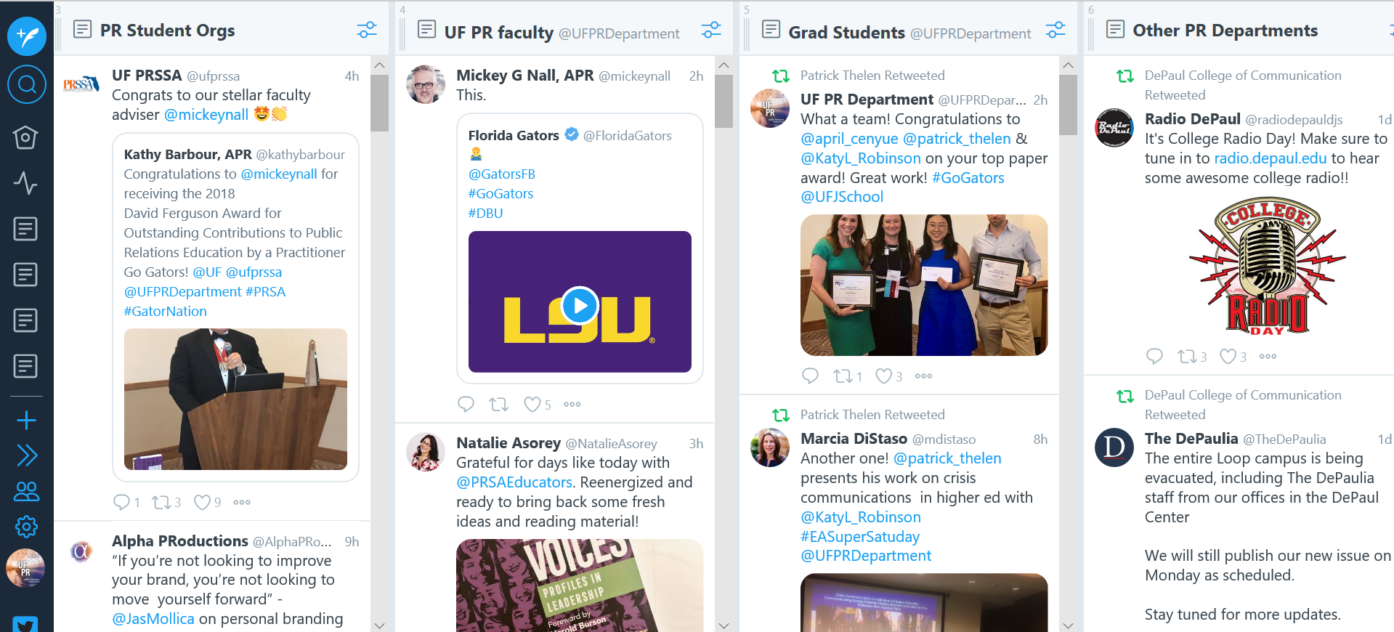
Free Twitter Content Management
@mdistaso

Slide 18
Have fun!
@mdistaso

Slide 19
Thank you!
Marcia DiStaso, Ph.D. APR
Chair Public Relations Department
@mdistaso
Marcia DiStaso

